Slide 1

NATIONAL PARKS BIODIVERSITY DATABASE
Team: Max Becker, Michael Bowman, Anna Howell, and Adrian Williams
Notes:
Max

Slide 2
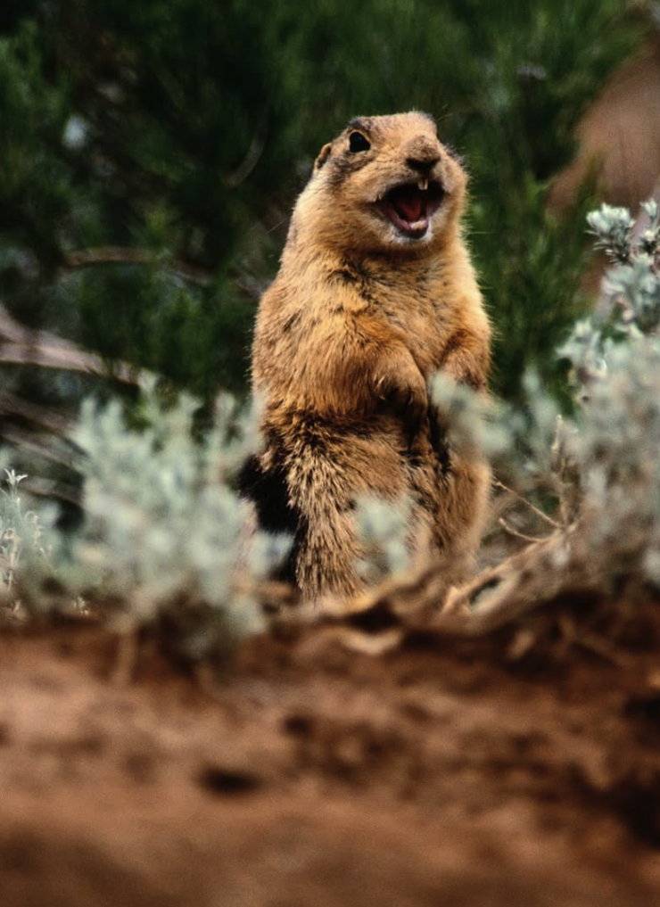
Table of Contents
Project Overview
Data Sources
Technologies Used
ETL Workflow
Database Design
Connecting to PostgreSQL
Retrieving PostgreSQL
Merging Databases
Reorganizing columns
Saving Output & Closing SQL Connection
Ethical Considerations
Notes:
Max

Slide 3
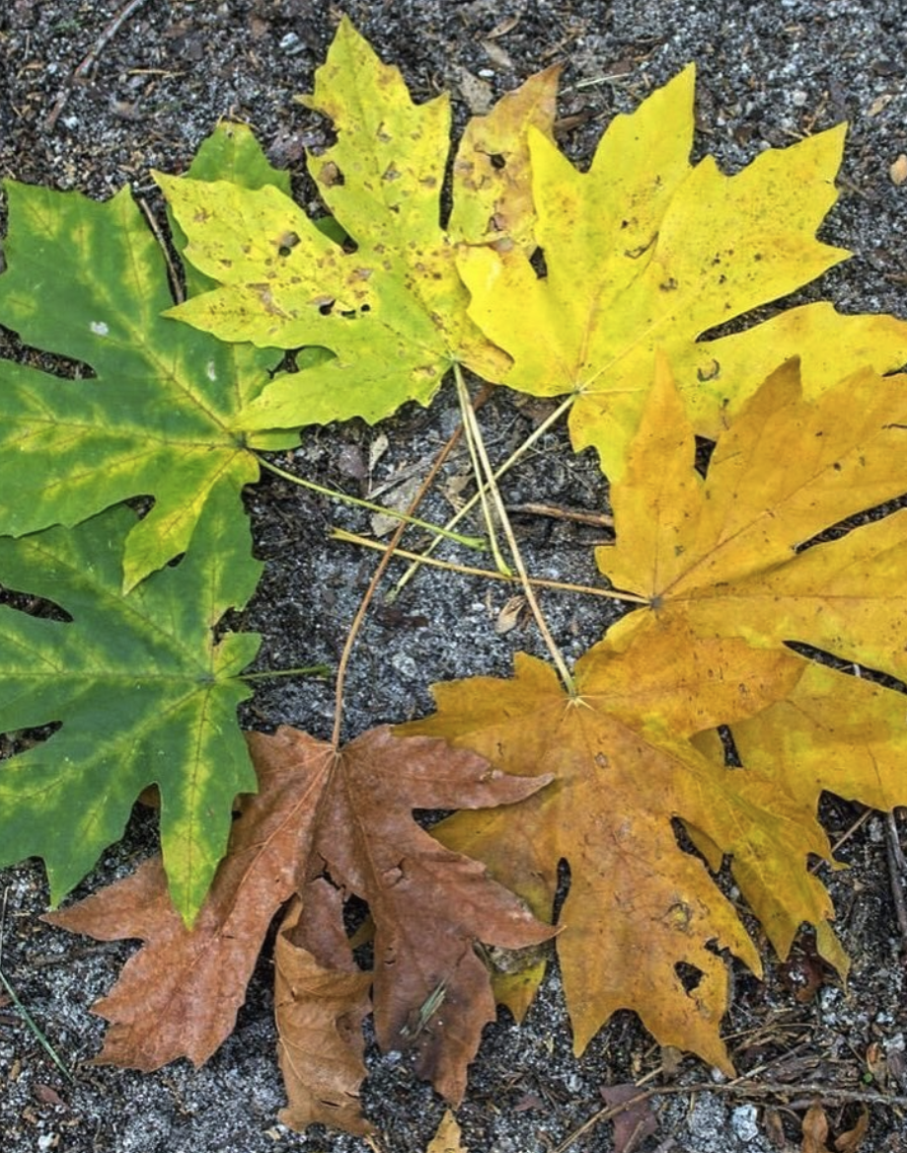
Project Overview
This National Parks Biodiversity Database project investigates the diversity of species observed across 4 U.S. National Parks.
The database also includes relevant geographical and environmental data such as park location and acreage.
By centralizing this information into a structured SQL database, we enable efficient querying and exploration of trends related to conservation efforts, species habitats, and biodiversity richness.
Notes:
Adrian

Slide 4

Data Sources
https://www.kaggle.com/datasets/nationalparkservice/park-biodiversity
https://www.kaggle.com/datasets/mathisjander/biodiversity-in-national-parks-project
Notes:
Adrian

Slide 5
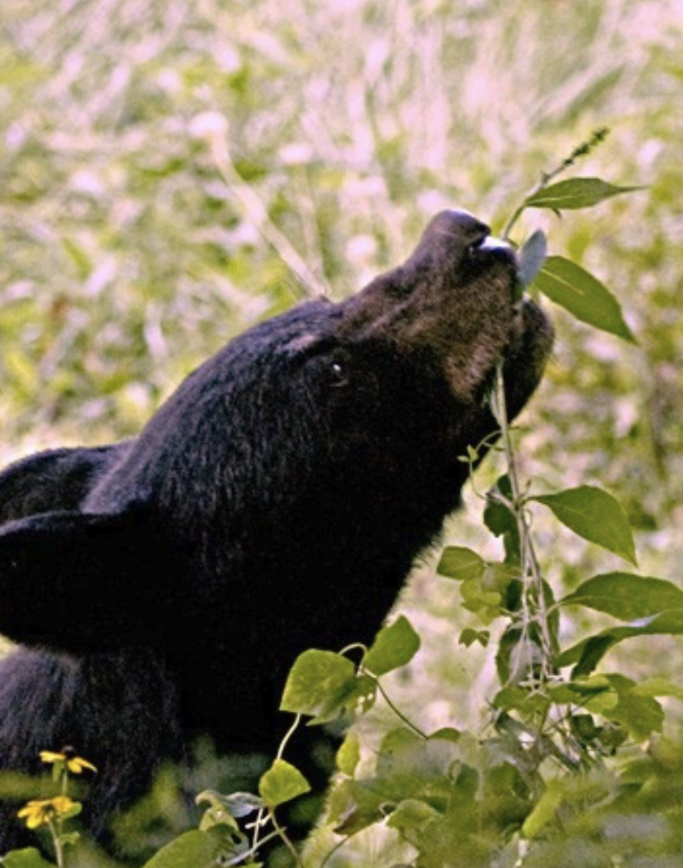
Technologies Used
Jupyter Notebooks
Python
Pandas (for general-purpose data analysis)
Polars (for high-performance column and string operations)
PostgreSQL (via psycopg2 for PostgreSQL access)
Notes:
Adrian

Slide 6
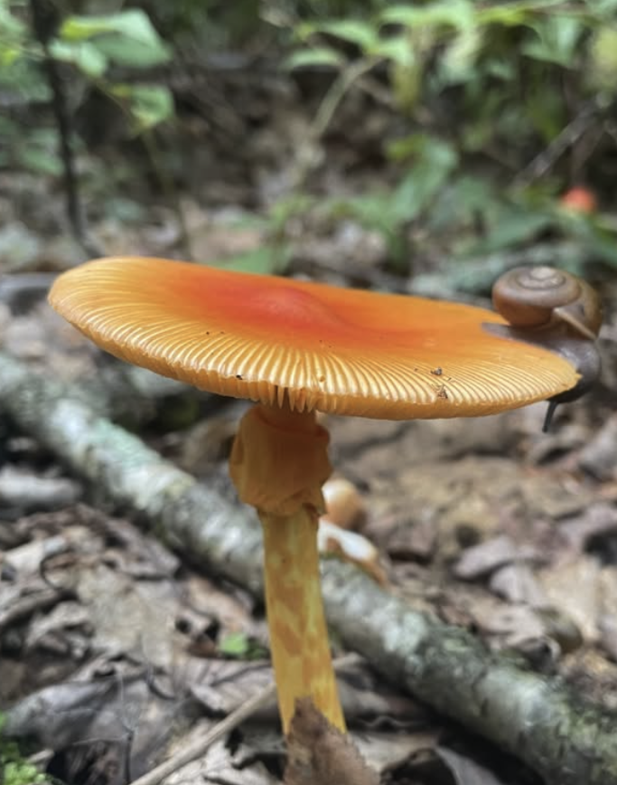
ETL Workflow: Extract
Extracting three primary CSV datasets from Kaggle.com:
Parks.csv (Park metadata)
Observations.csv (Species observations)
Species_info.csv (Species classification and conservation info)
Notes:
Anna

Slide 7
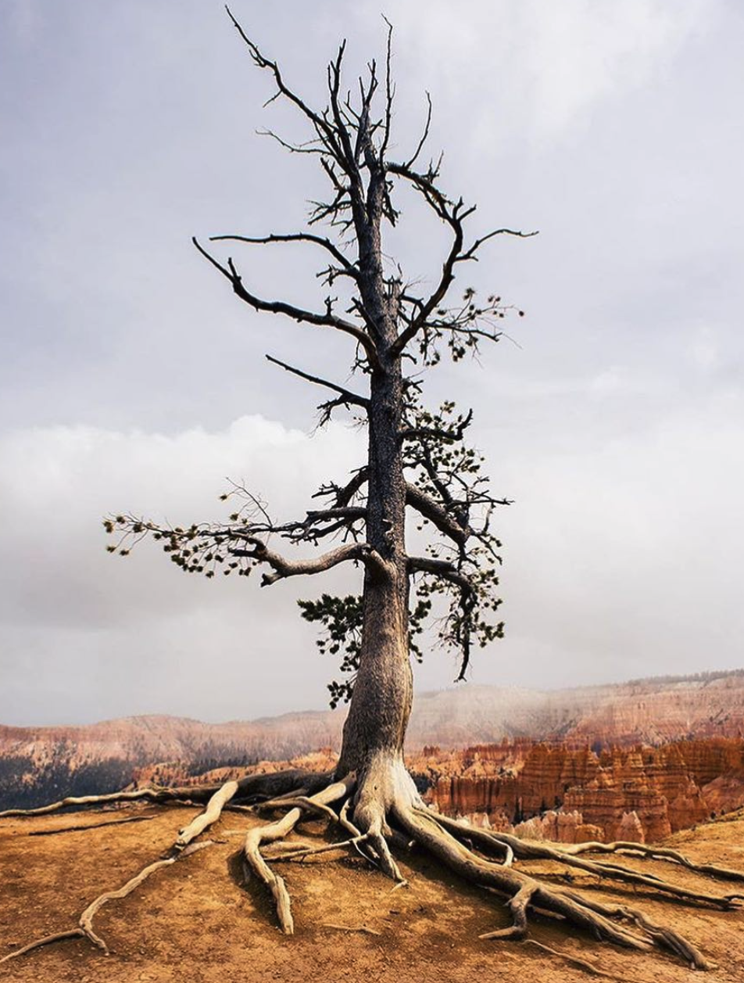
ETL Workflow: Transform
Transforming the data by:
Renaming inconsistent columns
Park Name -> park_name, Park Code -> park_code
Renaming inconsistent park names
Bryce Canyon National Park -> Bryce National Park
Saving the cleaned dataset to a new file called: parks_updated.csv
Notes:
Anna

Slide 8
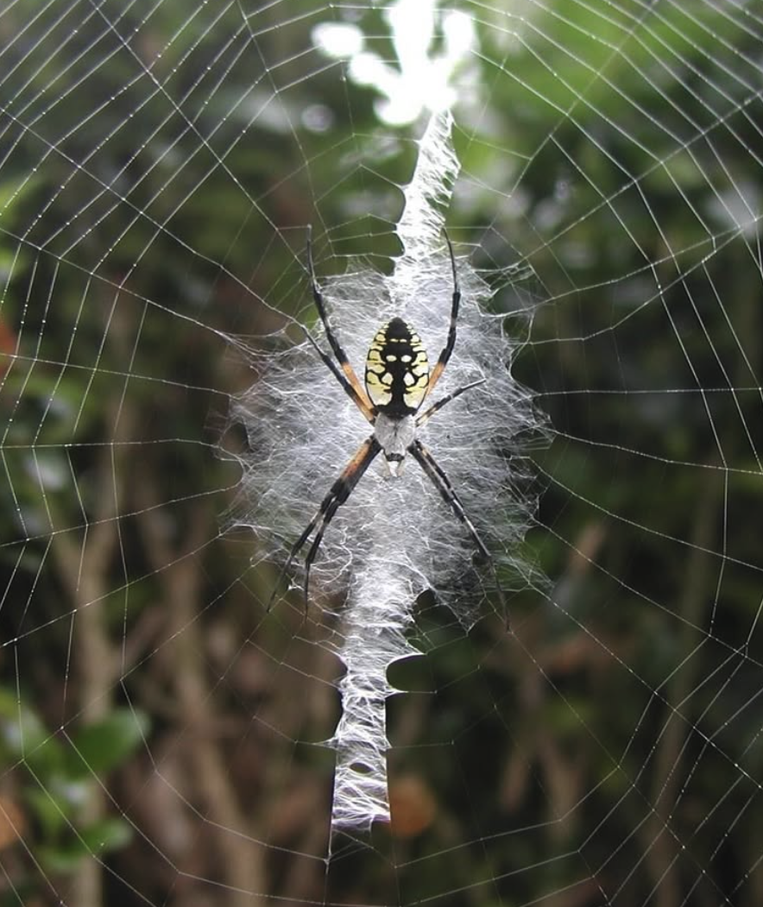
ETL Workflow: Load
Loading the cleaned and joined data into a relational SQLite database (national_park_species_db.sql) with 3 tables:
observations, parks_updated, and species_info
Notes:
Anna

Slide 9
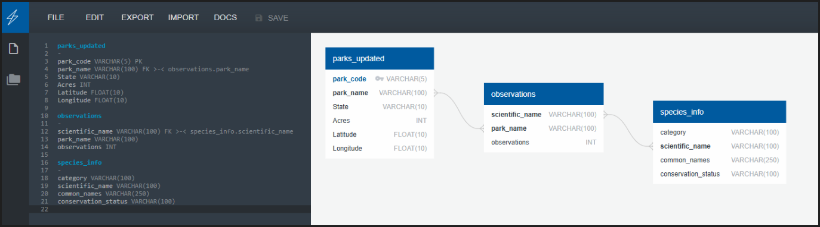
Database Design
We chose https://www.quickdatabasediagrams.com/ as our ERD tool
Notes:
Adrian

Slide 10
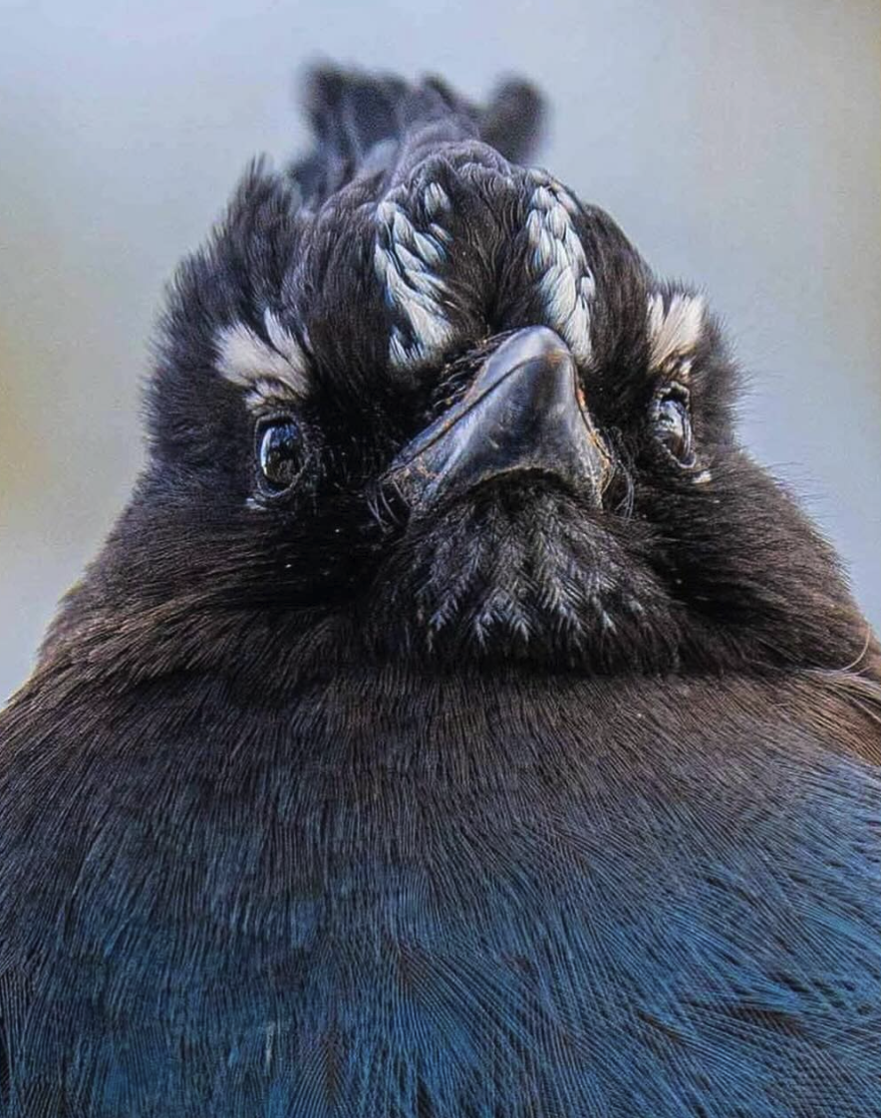
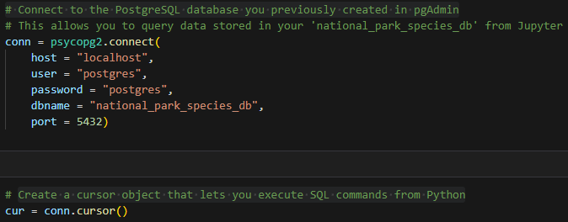
Connecting to PostgreSQL
Connect to the PostgreSQL database that was previously created in pgAdmin4
Create a cursor object that lets you execute SQL commands from Python
Execute SQL to retrieve all rows from the 'observations' table
Notes:
Mike

Slide 11
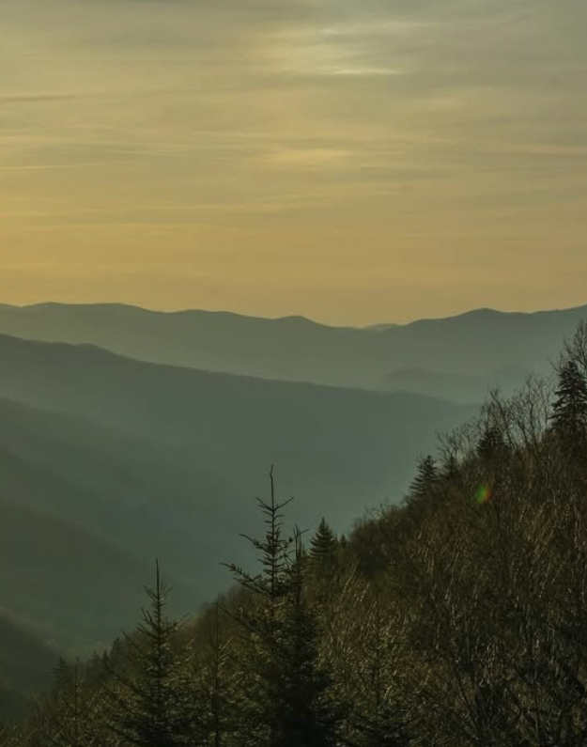
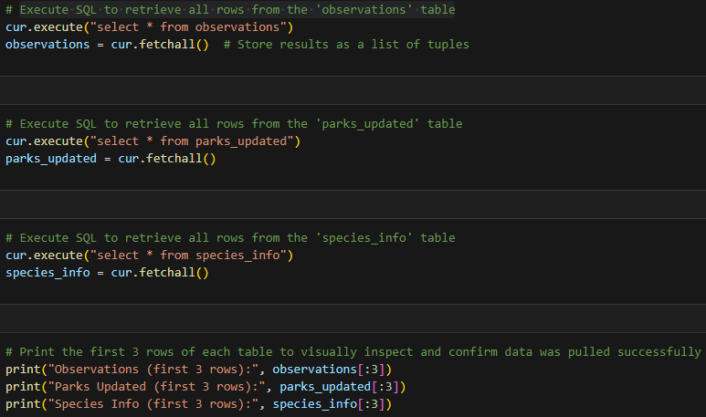
Retrieving PostgreSQL Database / Tables
Execute SQL to retrieve all rows from the observation, parks_updated, and species_info tables
Print the first 3 rows to confirm data was pulled successfully
Notes:
Mike

Slide 12
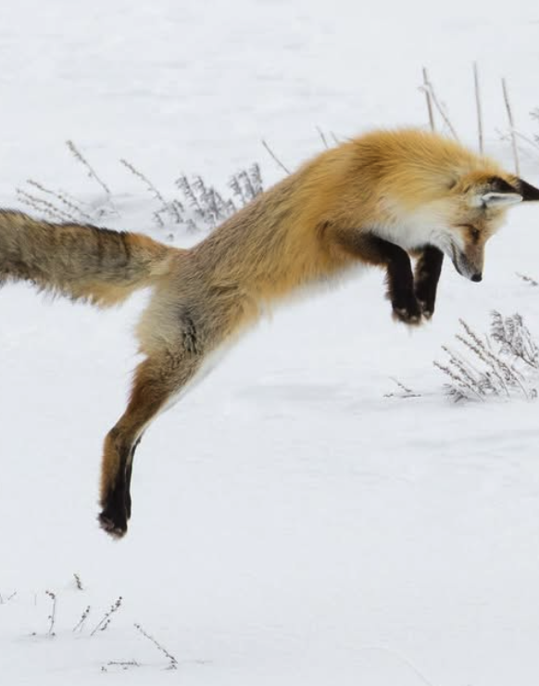
Merge database tables into single query
Perform LEFT JOINs using SQL directly from Python:
Join 'observations' with 'parks_updated' on 'park_name’
Then join that result with 'species_info' on 'scientific_name’
Print the first 3 rows from the final joined dataset to validate merge success
Notes:
Max

Slide 13
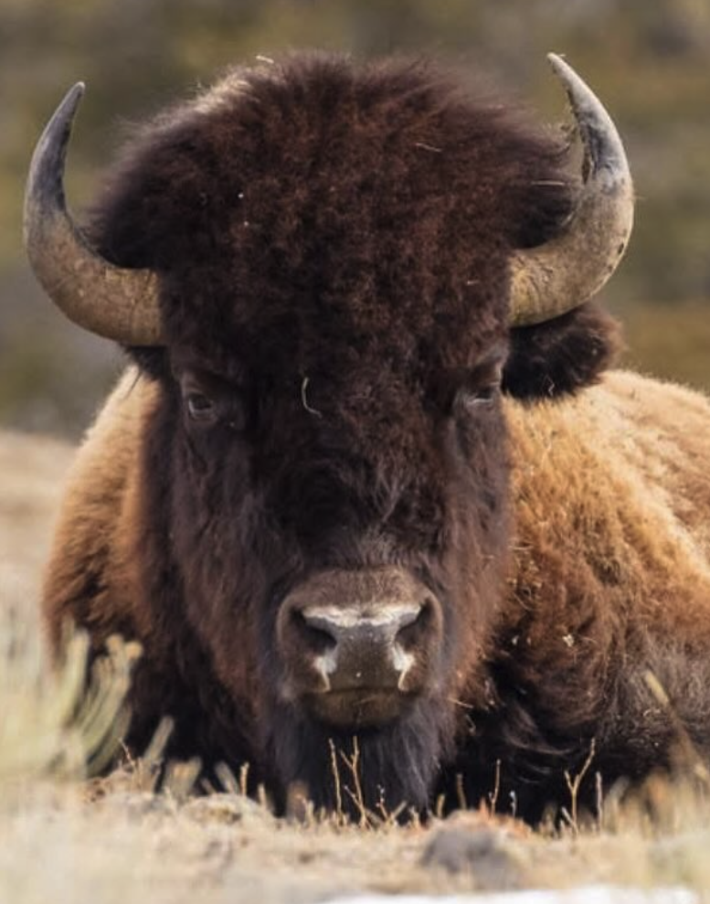
Reorder the columns to improve readability
Define current column headers that match SQL SELECT statement above
Convert that list to a Pandas DataFrame
Create new order of column headers and apply it to the DataFrame
Notes:
Mike

Slide 14
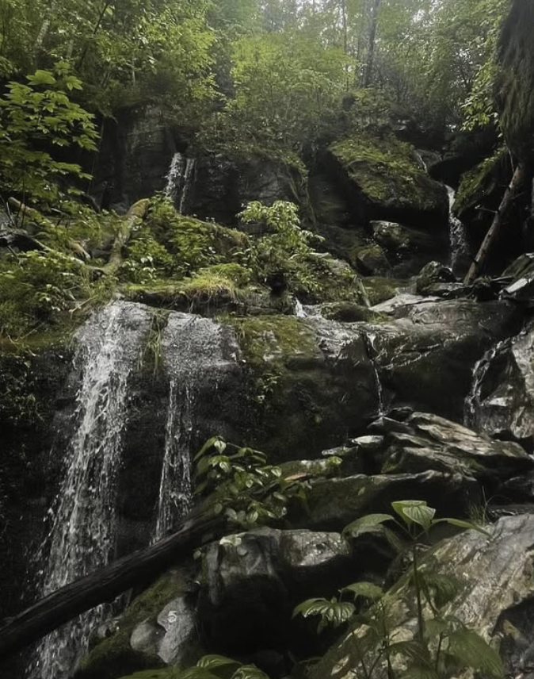
Save final merged dataset & close SQL connection
Save the final merged dataset to a CSV file in the 'resources' folder
Close the connection to the PostgreSQL database once all queries are complete
Notes:
Mike

Slide 15
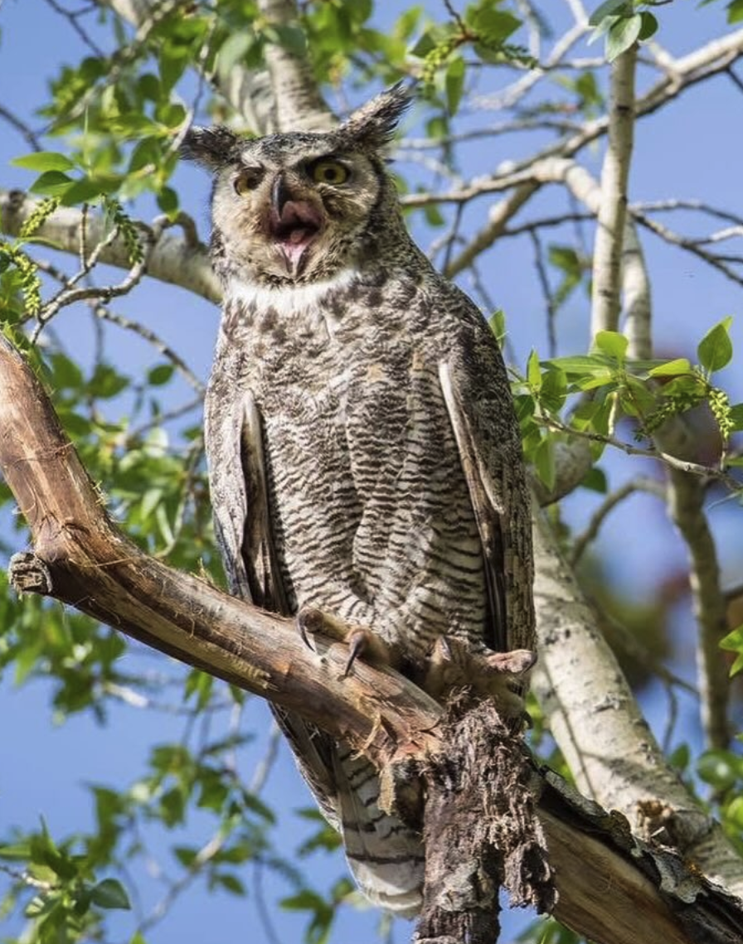
Ethical Considerations
Data Privacy: The datasets do not include personally identifiable information. All data pertains to publicly available environmental statistics and species info.
Conservation Awareness: We emphasize the importance of responsible ecological studies. Our goal is to raise awareness about endangered species and biodiversity patterns without exploiting or misrepresenting ecological data.
AI Usage Transparency: AI (ChatGPT) was used as a guide during project design, troubleshooting, and documentation. All generated content was reviewed by human team members.
Notes:
Mike

Slide 16
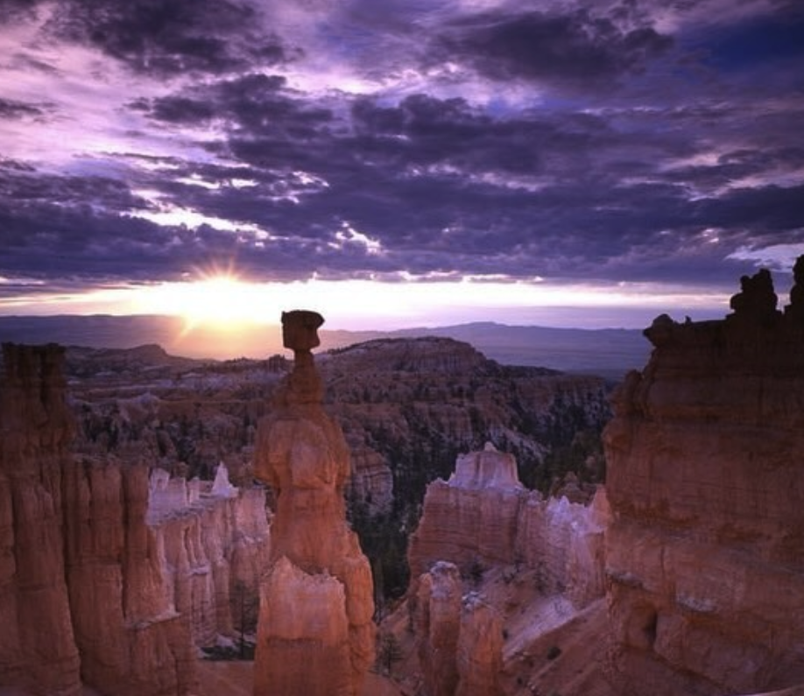
THANK YOU!
Notes:
Anna

